Slide 1
Explain Risk Management Processes
CompTIA Security+ Exam SY0-701
Lesson 15

Slide 2
Risk Management Processes and Concepts
Lesson 15
Topic 15A

Slide 3
Risk Identification and Assessment
Risk identification is fundamental to managing risk
  Malware attacks
  Phishing attempts
  Insider threats
  Equipment failures
  Software vulnerabilities
  Nontechnical risks like inadequate policies or training
Risk assessment evaluates previously identified risks to determine their potential impact on the organization

Slide 4
Risk Identification and Assessment
Risk Analysis
  Describes identifying and evaluating potential risks and the characteristics that define them
Quantitative Analysis
  Assign tangible values to each risk
Qualitative Analysis
  Assess risks based on subjective judgment
Risk Assessment
  Estimates potential risk levels and their significance by interpreting data collected during risk analysis
Notes:
Ensure students understand these metrics.

Slide 5
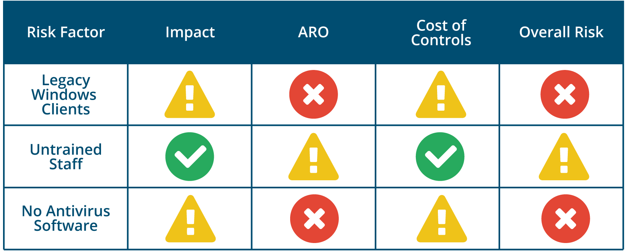
Risk Identification and Assessment
Inherent Risk
  Level of risk before any type of mitigation has been attempted
Heat Map
Traffic light impact grid.

Slide 6
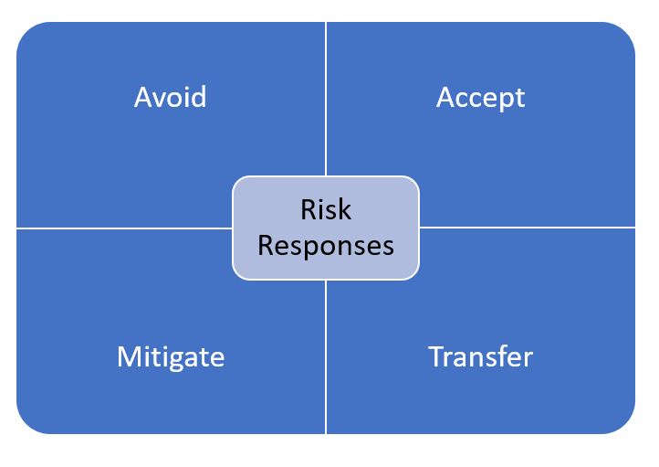
Risk Management Strategies
Risk management strategies
  Describe the proactive and systematic approaches used to identify, assess, prioritize, and mitigate risks to minimize their negative impacts
Risk responses
  Identify how risk items are managed
The four risk responses are avoid, accept, mitigate, and transfer.

Slide 7
Risk Management Strategies
Residual Risk
  The amount of risk left after mitigations are implemented
  Risk cannot be fully eliminated
Risk Appetite
  Acceptable levels of risk
  Varies from one organization to another
  Sometimes defined in a formal risk appetite statement
Notes:
Make sure students can distinguish types of risk response.

Slide 8
Risk Management Processes
Identifying, assessing, and mitigating vulnerabilities and threats to the essential functions that a business must perform to fulfill its purpose
Risk
  A measure of threats, vulnerabilities, impact, and probability
Risk Registers
  Risk description
  Severity
  Owner of the risk item
  Identified mitigations
  Often utilize heat maps

Slide 9
Risk Management Processes
Risk Threshold
  Defines the limits or levels of acceptable risk
Key Risk Indicators
  Predictive indicators for monitoring and predicting potential risks
Risk Reporting
  Communicate an organization's risk profile
  Communicate the effectiveness of a risk management program

Slide 10
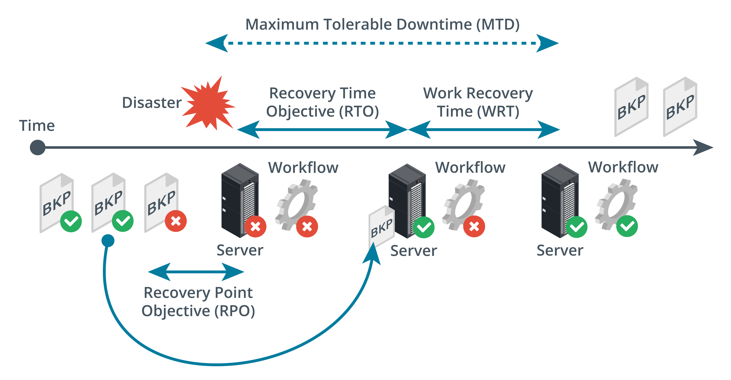
Business Impact Analysis
Identification of Critical Systems
Mission Essential Functions
Maximum Tolerable Downtime (MTD)
Recovery Time Objective (RTO)
Work Recovery Time (WRT)
Recovery Point Objective (RPO)
Metrics governing mission essential functions. (Images © 123RF.com.)

Slide 11
Risk Management Processes and Concepts
Risk Identification and Assessment
Risk Management Strategies
Risk Management Processes
Business Impact Analysis
Notes:
Take some time at the end of each topic to answer questions. You can use the review questions for discussion in class or set them for students to complete individually during or after class.

Slide 12
Vendor Management Concepts
Lesson 15
Topic 15B

Slide 13
Vendor Selection
Systematically evaluate and assess potential vendors to minimize risks associated with outsourcing or procurement
Third-Party Vendor Assessment
  Critical component of Governance, Risk, and Compliance (GRC)
  Vendor assessments provide evidence of due diligence
Conflict of Interest
  When an individual or organization has competing interests or obligations that could compromise their ability to act objectively, impartially, or in the best interest of the organization

Slide 14
Vendor Selection
Vendor Assessment Methods
  Evidence of Internal Audits
  Independent Assessments
  Penetration Testing
  Supply Chain Analysis
  Right-to-Audit Clause
Vendor Monitoring
  Continuously evaluating vendors to ensure ongoing adherence to security standards, compliance requirements, and contractual obligations

Slide 15
Legal Agreements
Initial Agreements
  Memorandum of Understanding (MOU)
  Nondisclosure Agreement (NDA)
  Memorandum of Agreement (MOA)
  Business Partnership Agreement (BPA)
  Master Service Agreement (MSA)
Operational/Performance Agreements
  Service-level Agreement (SLA)
  Statement of Work (SOW)/Work Order (WO)
Expectations
  Rules of Engagement (RoE)

Slide 16
Vendor Management Concepts
Vendor Selection
Vendor Assessment Methods
Legal Agreements
Notes:
Take some time at the end of each topic to answer questions. You can use the review questions for discussion in class or set them for students to complete individually during or after class.

Slide 17
Audits and Assessments
Lesson 15
Topic 15C

Slide 18
Attestation and Assessments
Attestation
  Verifying the accuracy, reliability, and effectiveness of security controls
Internal Assessment
  Organization's own employees conduct an in-depth assessment
  Relatively simple to perform and customize
External Assessment
  Independent Third-Party
  Impartial and objective evaluation of business practices
  Required for legal compliance
Notes:
External entities could include certified public accountants (CPAs), external auditors, consulting firms, regulatory bodies, or specialized assessment agencies. The independence of these external assessors ensures impartiality and objectivity in the evaluation process.

Slide 19
Penetration Testing
Uses authorized hacking techniques to discover exploitable weaknesses in the target's security systems.
Sometimes referred to as Pen Test or Ethical Hacking
Internal Pen Test performed by a “Red Team”
May include Active and Passive Reconnaissance
Known Environment Penetration Testing
Partially Known Environment Penetration Testing
Unknown Environment Penetration Testing
Notes:
Make sure students can distinguish vulnerability assessment from pen testing.

Slide 20
Exercise Types
Different types of penetration tests allow organizations to use a flexible and prioritized approach toward security assessment
Offensive Penetration Testing “Red Team”
Defensive Penetration Testing “Blue Team”
Physical Penetration Testing
Integrated Penetration Testing
  Combines different types of penetration testing techniques

Slide 21
Penetration Testing Concepts
Attestation and Assessments
Penetration Testing
Exercise Types
Notes:
Take some time at the end of each topic to answer questions. You can use the review questions for discussion in class or set them for students to complete individually during or after class.

Slide 22
Assisted Lab: Performing Reconnaissance
Assisted Lab: Performing Penetration Testing

Slide 23
Summary
CompTIA Security+ Exam SY0-701
Lesson 15

